Slide 1



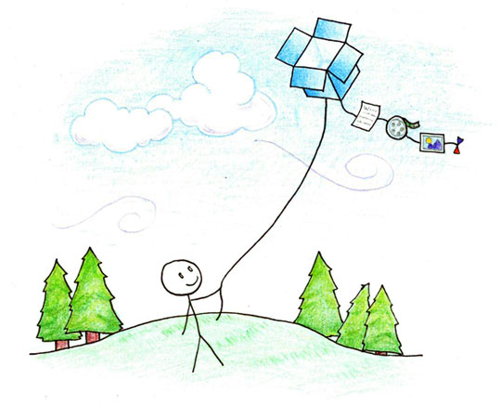
Efficient Batched Synchronization in Dropbox-like Cloud Storage Services
Zhenhua Li *, Peking U & Tsinghua U
Christo Wilson, Northeastern University
Zhefu Jiang, Cornell University
Yao Liu, Binghamton University
Ben Y. Zhao, UCSB
Cheng Jin, University of Minnesota
Zhi-Li Zhang, University of Minnesota
Yafei Dai, Peking University
lizhenhua1983@gmail.com
http://www.greenorbs.org/people/lzh/
Dec. 12th, 2013

Slide 2
Outline
Background & Problems
Understanding Dropbox
UDS middleware to address the problems
inotify+ & UDS+
The End

Slide 3
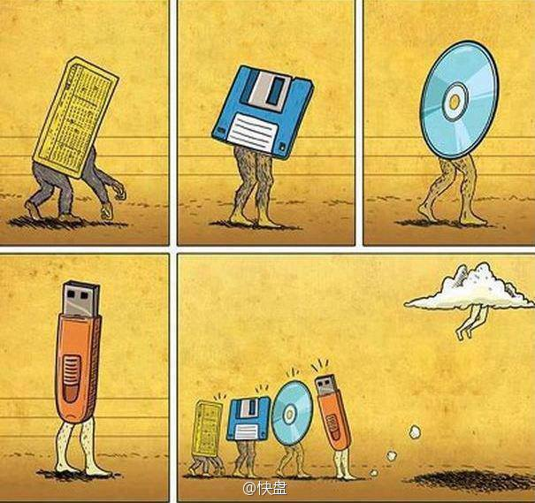
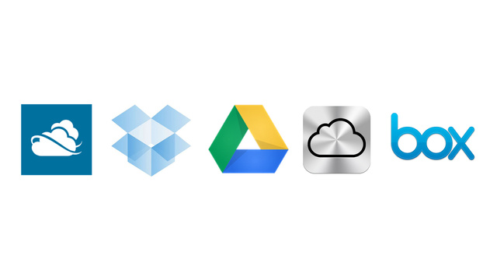





Cloud Storage Service
Enabled by Cloud Computing & Internet Broadband
Extremely popular in recent years
SkyDrive: 200 M users
Dropbox: 100 M users
Google Drive: numerous …
Apple iCloud: countless …
Box.com: 14 M users
Notes:
节点，可以大到一个数据中心，也可以小到一部手机、一个传感器、一个电子标签。

Slide 4
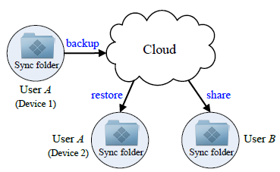




The Same Target
Provide Internet users with a convenient & reliable solution to store and share data
From anywhere, on any device, at any time
Notes:
节点，可以大到一个数据中心，也可以小到一部手机、一个传感器、一个电子标签。

Slide 5
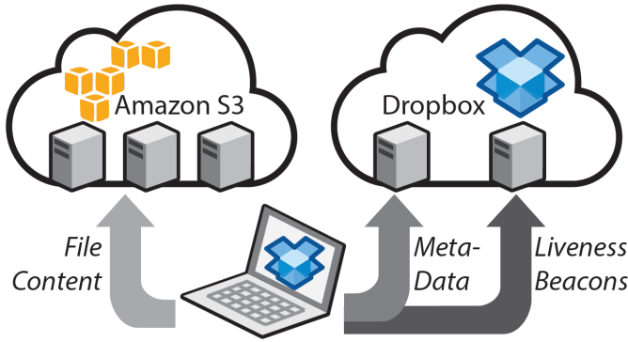
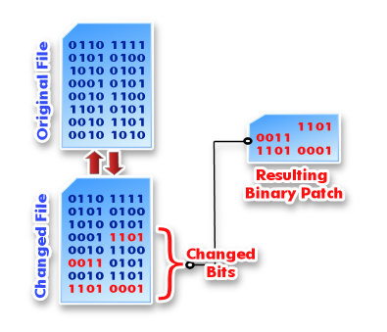

Dropbox is the Market Leader
- Over 100 M users who store/update 1 billion files per day!
- In average, $4.8 revenue per user every year
How can Dropbox compete with so many market giants?
_{Delta sync}
_{+ compression}
_{= Saving traffic}
Easy scalability & high reliability

Slide 6
Saving traffic: Dropbox vs. Others
A simple example: append 100 MB of identical characters, e.g. ‘a‘, to an existing file in the sync folder
Network traffic:
> 100 MB
> 100 MB
> 100 MB
40 KB
> 100 MB
Dropbox is really good at saving traffic!
Notes:
节点，可以大到一个数据中心，也可以小到一部手机、一个传感器、一个电子标签。

Slide 7
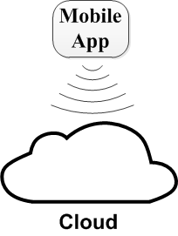
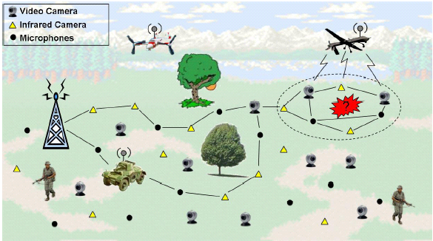

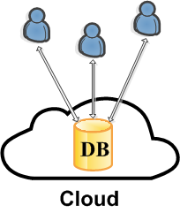


So, I rely on Dropbox more and more
To do a lot of advanced things
Periodical data collecting
Collaborative document editing
Database hosting
File download
(directly)
Frequent, short data updates !

Slide 8
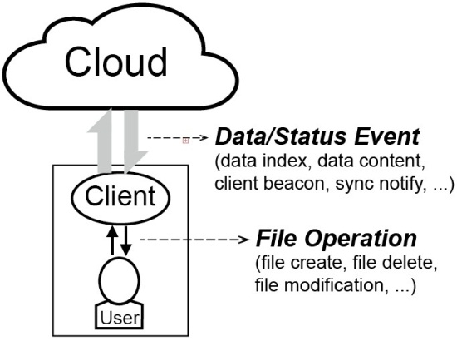
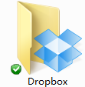
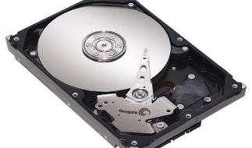
But, this time Dropbox let me down …
For example: periodically collect 1 MB of data
(1 KB/ 5 sec)
2 MB?
5 MB?
10 MB?
1 MB
Internet
45 MB
Frequent, short data updates
time
Session maintenance traffic far exceeds real data update size
Network traffic for data synchronization
The Traffic Overuse Problem

Slide 9
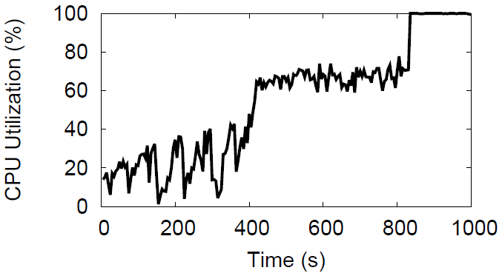
Not only Traffic Overuse, but also Computaion Overuse
Frequent, short data updates also lead to …
8 MB: 70%
Dropbox
4 MB: 35%
The Computation Overuse Problem
CPU utilization grows as the file size increases

Slide 10
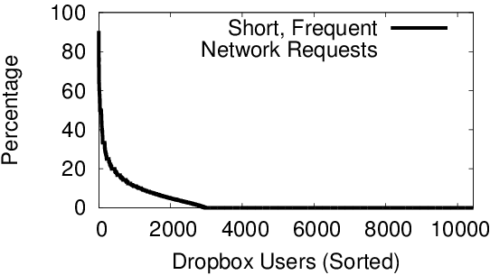
Question: Are these problems pervasive or nitpicking?
[IMC 2012] Measurement of Dropbox traffic in two European university campuses and two residential districts, involving 10,000+ users and millions of data updates
For 8.5% Dropbox users, >10% of their traffic is generated in response to frequent, short updates
As cloud computing becomes more pervasive, more local things will be migrated to the cloud, thus involving more frequent, short data updates !

Slide 11
Outline
Background & Problems
Understanding Dropbox
UDS middleware to address the problems
inotify+ & UDS+
The End

Slide 12
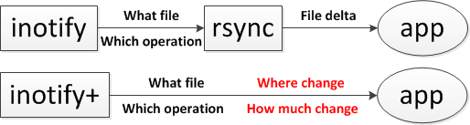
Deep Understanding of Dropbox
How does the Dropbox client work?
We use “strace dropbox” on top of Linux
And meanwhile record & analyze the communication packets to figure out the working principle of Dropbox client
(1) Recalculating
& (2) Delivering
the changed bits
Traffic & Computation

Slide 13
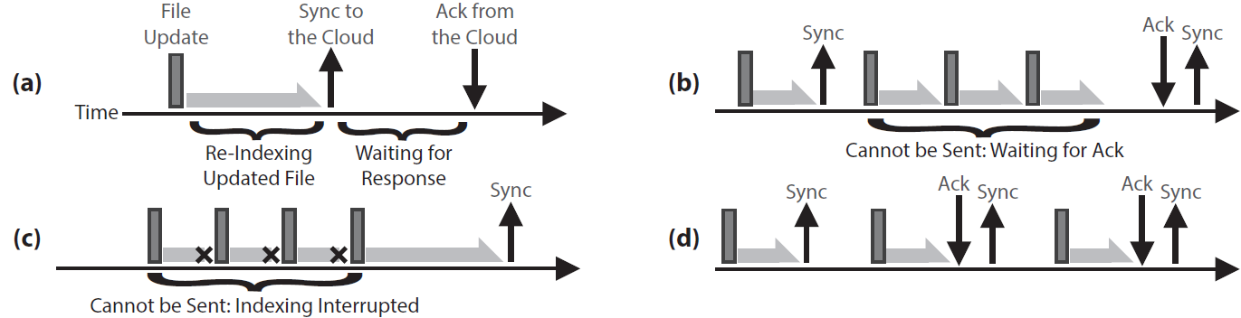
Working Principle of Dropbox Client
The four basic components of Dropbox client behavior
First, Dropbox client must re-index the updated file --- computation intensive
A file is considered “synchronized” to the cloud only when the cloud returns ACK
This is why some data updates are “batched” for synchronization unintentionllay
Sometimes, when data updates happen even faster than the file re-indexing speed, they are also “batched” for synchronization

Slide 14
Outline
Background & Problems
Understanding Dropbox
UDS middleware to address the problems
inotify+ & UDS+
The End

Slide 15
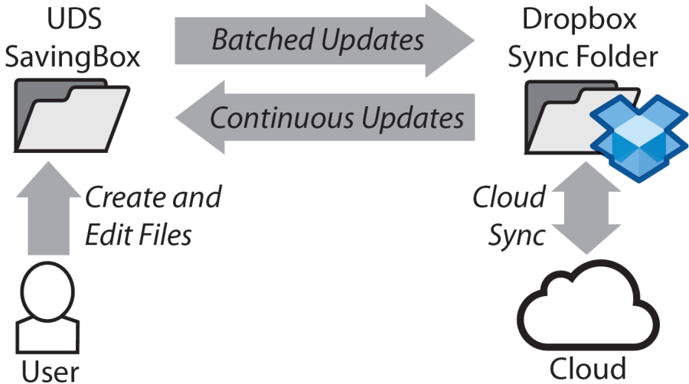
UDS middleware
Given that batched sync can effectively save traffic …
- Why not intentionally perform batched sync?
Update-batched Delayed Sync
- Set a middlebox and a byte counter for the batched updates
- Frequent, short updates are batched in a controlled manner
UDS: the straightforward solution
(still using inotify & rsync)
15

Slide 16
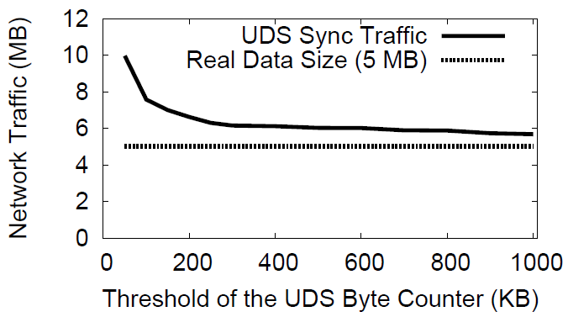
UDS byte counter
What is a proper size of the byte counter?
Non-linear
Linear
Inflection point
Byte counter = 250 KB
16

Slide 17
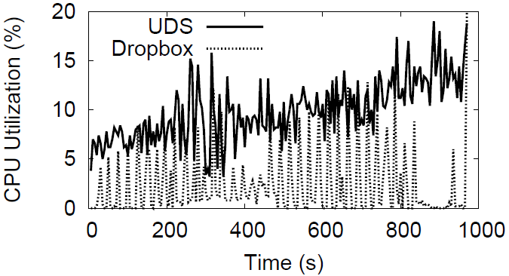
Real Effect of UDS
Dropbox traffic
UDS traffic
Dropbox
17

Slide 18
Outline
Background & Problems
Understanding Dropbox
UDS middleware to address the problems
inotify+ & UDS+
The End

Slide 19
The story is not over yet …
UDS has two potential shortcomings:
Middlebox costs extra storage space
CPU utilization still grows with the file size
19

Slide 20
What if inotify reports more …
Why we need rsync?
(1) Recalculating
& (2) Delivering
the changed bits
Traffic & Computation
Is it possible to directly get the changed bits without rsync (only with inotify)?

Slide 21
Implementing inotify+
inotify+ is possible, but requires modification to the Linux kernel, as inotify is a kernel API
Modify the Linux kernel with 160 lines of code
We are exposing the offset and size of changed bits, not calculating them!

Slide 22
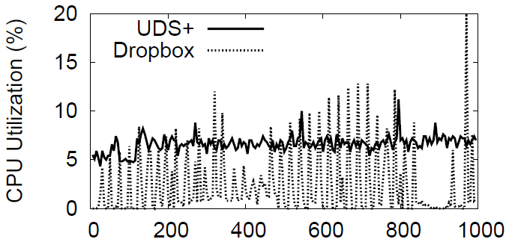
inotify+ → UDS+
1. Almost zero extra storage space
Dropbox
22

Slide 23
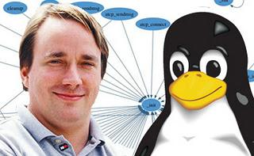
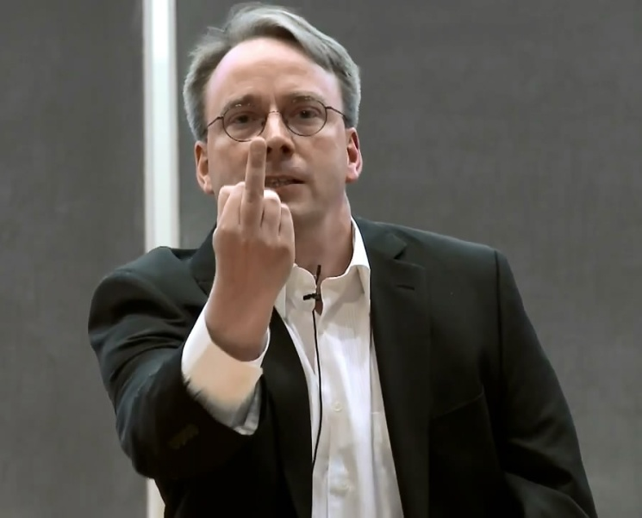
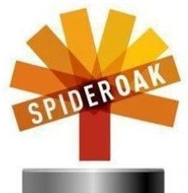
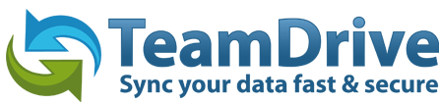
Modifying the Linux kernel …
Are we asking for troubles to modify the Linux kernel? If Linus Torvalds (Linux kernel community) disagrees …
Our essential goal: To demonstrate and advocate that a more general, powerful (and secure) filesystem event reporting kernel API (inotify+) is worthwhile for optimizing cloud storage services.
The major concern lies in security issues …

Slide 24

The End
Linux kernel patch for inotify+ :
http://www.greenorbs.org/people/lzh/public%20data/inotify-patch.html
We also have a live demo poster
Find me & talk more!
Middleware’13 Live Demo Poster:
T-CloudDisk: A Tunable Cloud Storage Service for Flexible Batched Synchronization

Slide 26


Other cloud storage services
& Operating systems

Slide 27
Drawback of Our Research
Black-box measurement and middleware solution are very insufficient
What happens after the data packet dives into the cloud?
“Google Drive, SkyDrive and Dropbox do have problems. But have you considered the problems from a system design/tradeoff perspective?”

Slide 28
So the ThuCloudDisk project started …
We are re-developing a small-scale Dropbox from scratch
White-box measurement
Full knowledge of the system
Add any function as we like
Middleware’13 Live Demo Poster:
T-CloudDisk: A Tunable Cloud Storage Service for Flexible Batched Synchronization

Slide 29
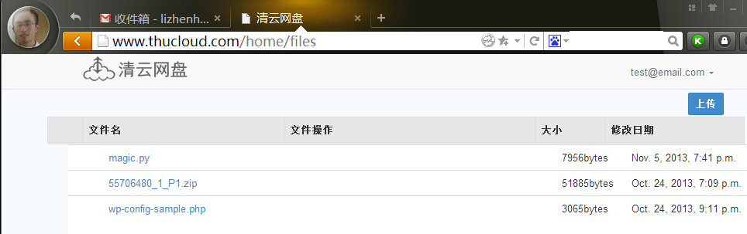

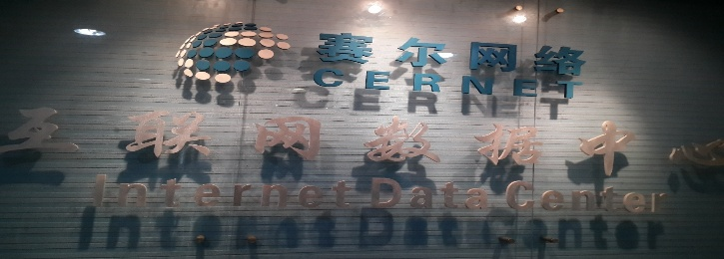
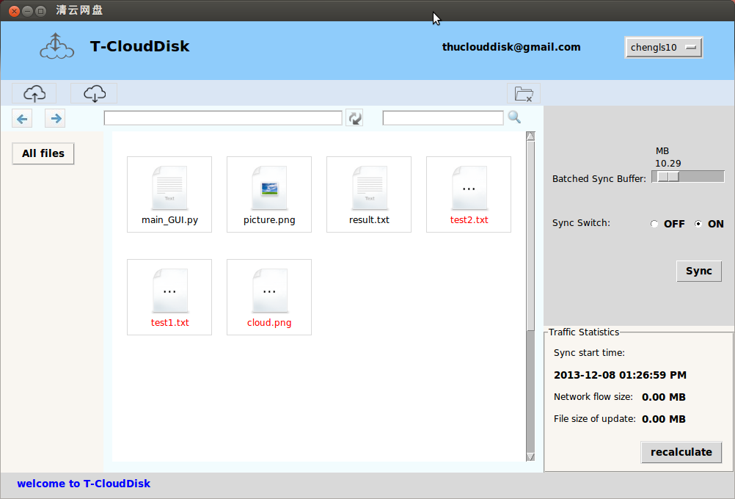

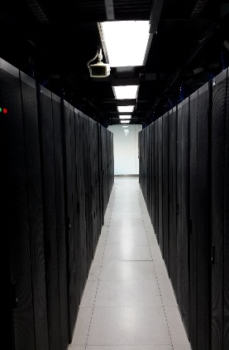
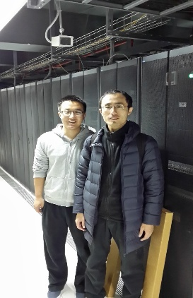
http://www.thucloud.com

